Slide 1


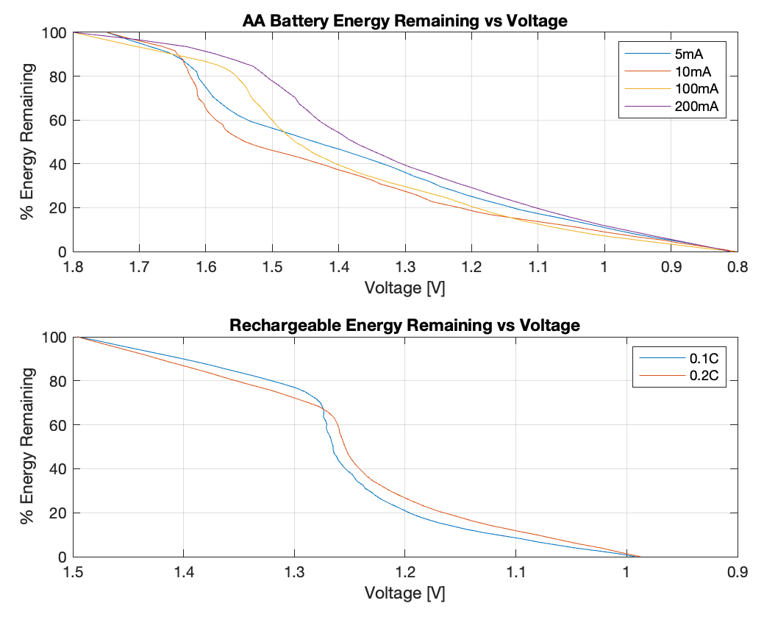
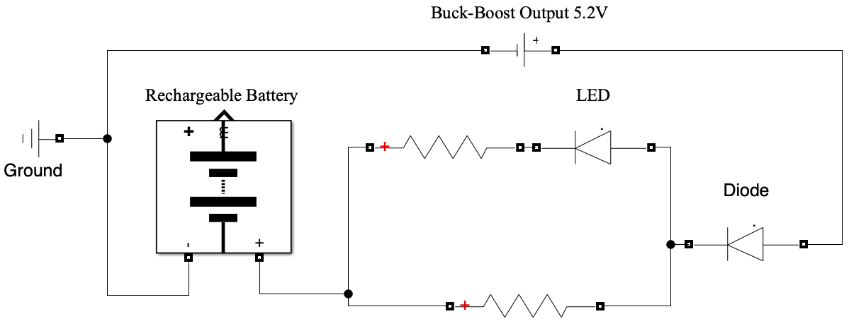
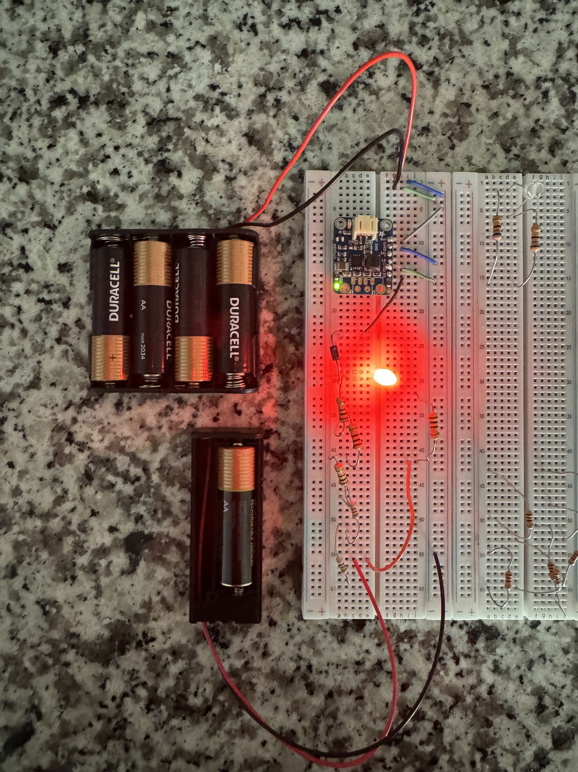
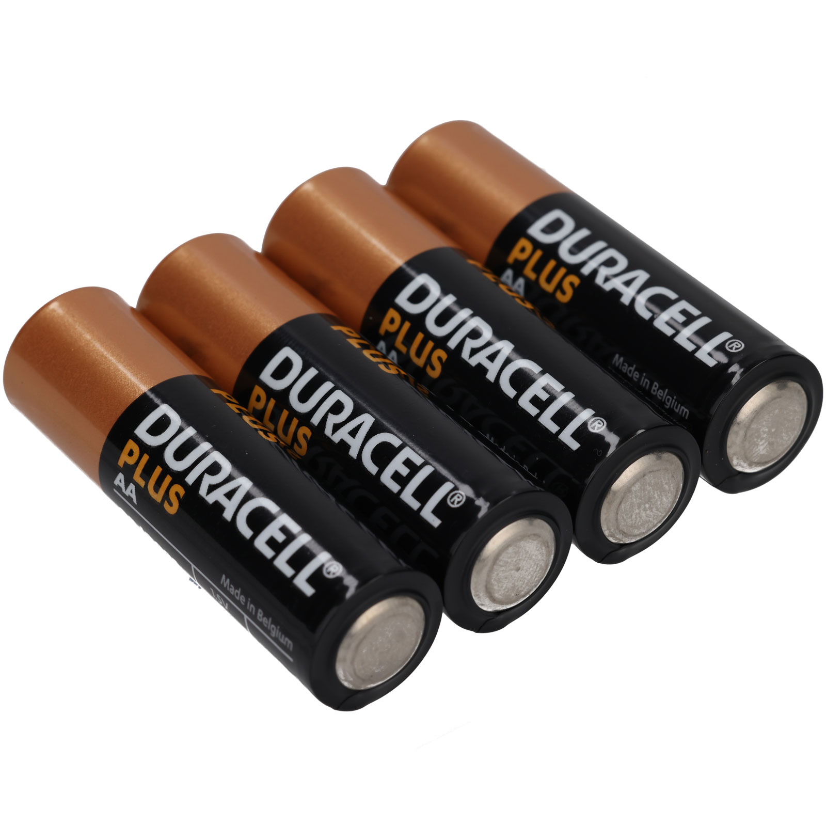
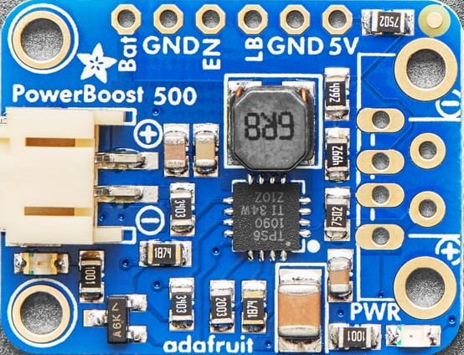
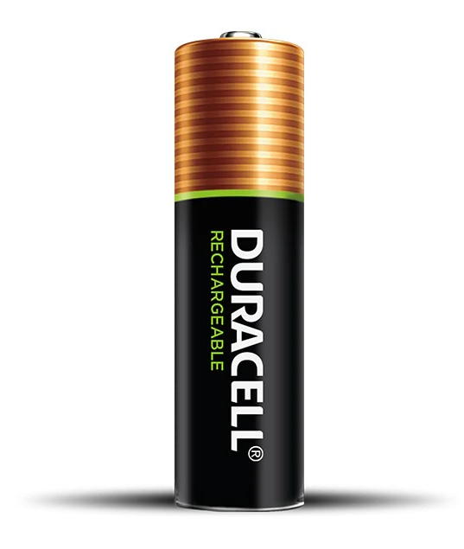
24-401
The Battery Vampire 2.0
Team members: Bruno Da Silva, RJ Dalusung, Yanal Matar, Ryan Rolle | Faculty adviser & Mentor: Dr. Gary Atkinson
Background
NiMH Charging
Targets and Setup
Battery disposal creates a lot of hazardous waste materials
These “dead” batteries still contain around 1.2-1.3V on average left, with some measuring up to 1.4V whereas fully charged batteries have 1.5V to 1.7V
Truly dead batteries are around 0.7V, where they have no energy left
Improved over 1.0 which was inefficient energy-wise (~30%) and also charged a power bank instead of AA batteries
For efficiency, we used slow charging at a low current (trickle charging)
Allows for the least amount of components, meaning more energy transfer to the rechargeable battery
Higher charging rates introduce need for thermal detection and other protective measures, meaning more circuits
Target ~0.01C charging rate, where C is capacity of battery.
2500 mAh battery would translate to ~25mA of current to the battery
Input Voltage (4 AA) | Output Current | Starting NiMH Voltage | Target NiMH Voltage
2.8V – 5.6V | 20-30mA | 0.7V | 1.5V
Efficiency
1.0 had a more complex circuit that included a buck-boost as well as a dedicated charging circuit
2.0 has a much simpler circuit that includes only a buck-boost and a few other components
By being more energy efficient, less energy is wasted when discarding them, thus decreasing the impact of battery waste
PowerBoost 500 Buck-Boost
Stabilized our voltage output to be constant
Takes input as low as 1.8V and outputs ~5.2V, good for our input range
Has power LED to show when it is outputting 5.2V
90%+ operating efficiency
Our Plan
Results
Use a buck-boost converter to maintain a constant voltage and current output from 4 dead AA alkaline batteries.
Take this and charge at least 1 rechargeable NiMH battery from ~0.7V to ~1.5V (from empty to full)
NiMH batteries have a nominal voltage of around 1.2V, where the ones we charged had an operating voltage range of 0.9-1.35V
It takes around 30 minutes to an hour to charge 1 NiMH battery from 0.7 to 1.2V, meaning you could have an operational battery in around an hour
Depending on the starting voltage, the charging LED stayed on for multiple hours meaning you could charge multiple batteries with the same set

